Slide 1
BREATHE TO SUCCEED
FINAL PROJECT PRESENTATION IN INTERNET OF THINGS
GROUP 5: JANA OMCIKUS, JULIA NADERER, ROHAN GUNDALA, SABIN PUN
LECUTER: PROF. DR. ANGELA NICOARA

Slide 2
TABLE OF CONTENTS
01
IDEA
03
RESULTS
02
SYSTEM IMPLENTATION
04
REFLECTION
Approach
Tests
Prototype
Problem
Motivation
Research
Overview
Architecture
Software Stack
Teamwork
Highlights
Future Improvements

Slide 3
01
IDEA

Slide 4



21.6
> 15
3.2 mil
PROBLEM
Hours spent indoors
Sicknesses related
Deaths attributed
Notes:
In the beginning of this course, we had to decide between two proposals. One was automatizing a neritp

Slide 5
MOTIVATION
Low Cost
User friendly
Precise
Interactive
Expendable
Interesting
Notes:
Given the problems you just heard, it is easy to guess that our first and foremost interest was to have less people suffer from the effects of bad air quality. Nonetheless, we wanted to hold ourselves to higher standards, and were motivated to come up with a solution that was
-
-
-
-
-
- Last but not least, we also had some self interest at heart. After having done some
e

Slide 6
Research
Dust & Particle Pollution
Future Features
01
02
03
04
Temperature and Humidity
Co2 & TVOC

Slide 7
02
SYSTEM IMPLEMENTATION

Slide 8
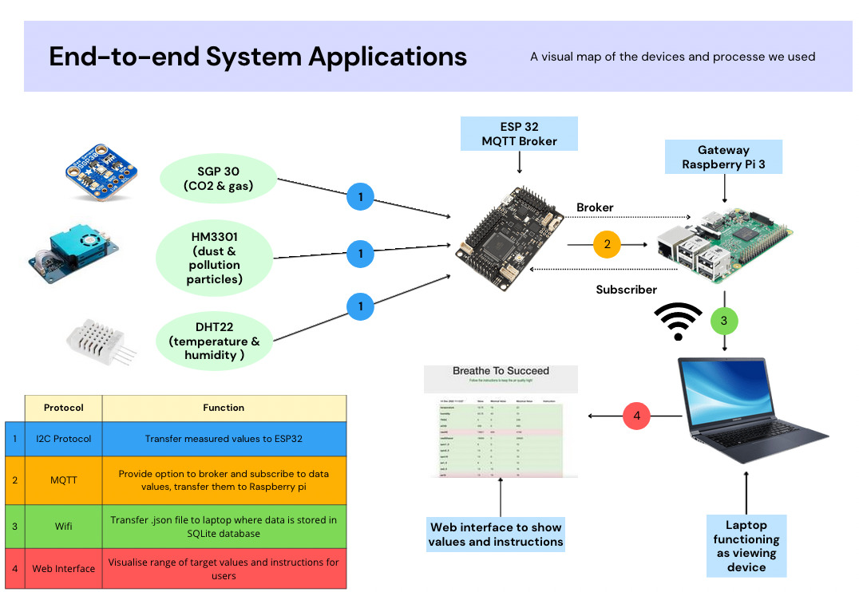
SYSTEM OVERVIEW

Slide 9
SYSTEM ARCHITECTURE
Notes:
Split into 3 parts

Slide 10
MICROCONTROLLERS
An ESP32 device collects sensor data using I²C, encodes into a JSON message and sends it via MQTT.
Notes:
Many of these devices

Slide 11
GATEWAY
Paho MQTT subscriber collects messages, decodes JSON and stores it in an SQLite database.
Notes:
-- The Pi acts as both the gateway and the backend/cloud.
-- Mention that it’s also the MQTT broker in this situation.
-- PYTHON script.

Slide 12
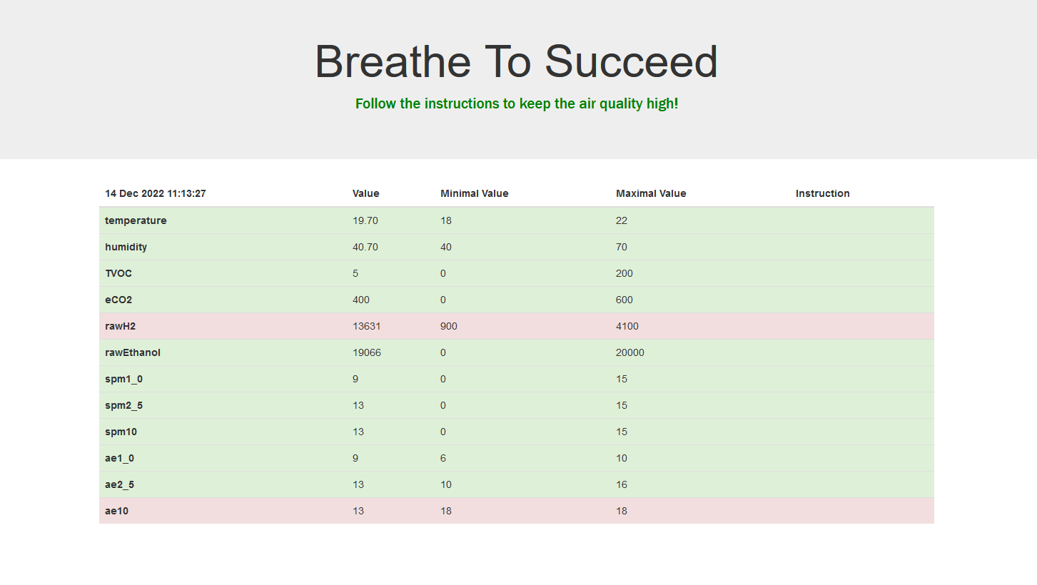
WEB FRONTEND
Node.js and Express HTTP server on the Pi serves the frondend and the data it requires.
Notes:
-- talk about why it’s not actual cloud.
-- this is why we chose the Pi – processing power
-- ? Maybe something about HTTP requests and JSON responses

Slide 13
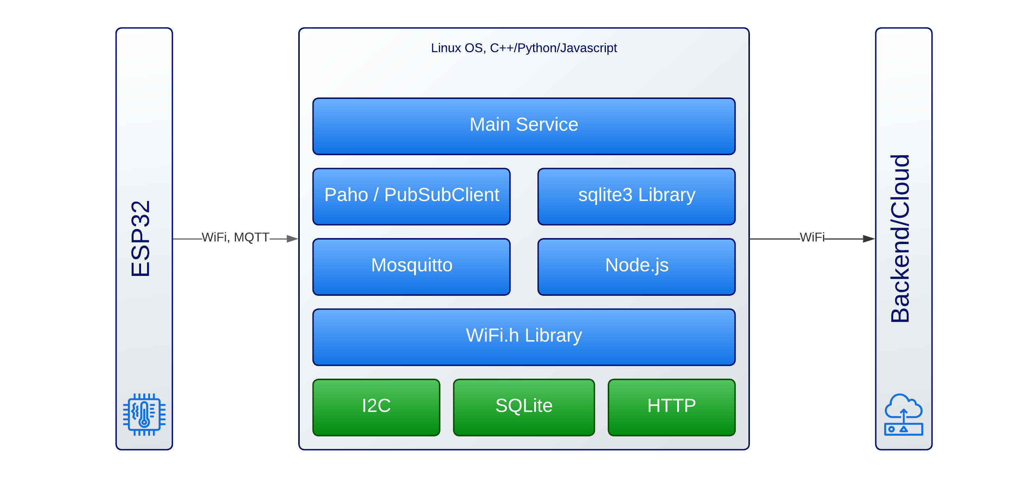
SOFTWARE STACK

Slide 14
03
RESULTS

Slide 15
APPROACH:
Assembling
Visualiziation
Getting the data to Raspberry pi for visualization
Connecting the sensors with ESP32
01
02
03
04
Components
Data
collecting data through different sensors
Getting all the right device
Buying the missing sensors

Slide 16
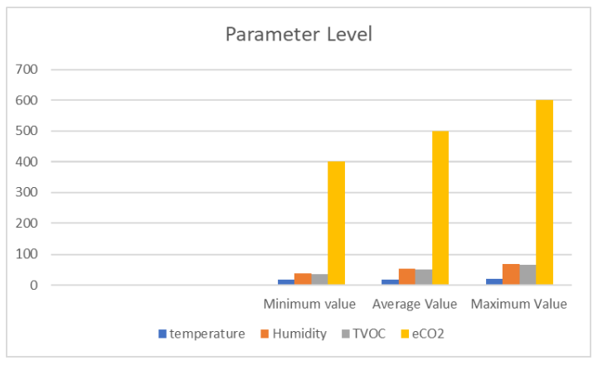
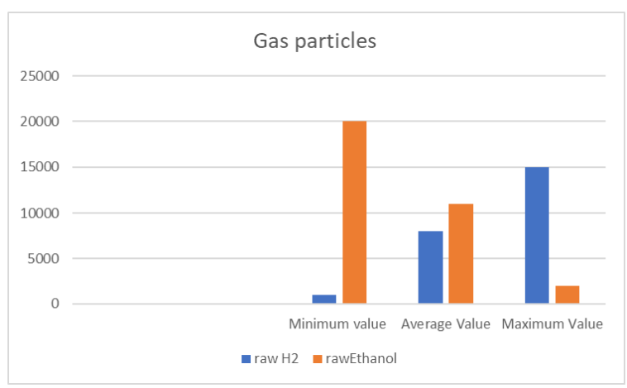
TESTS:

Slide 17
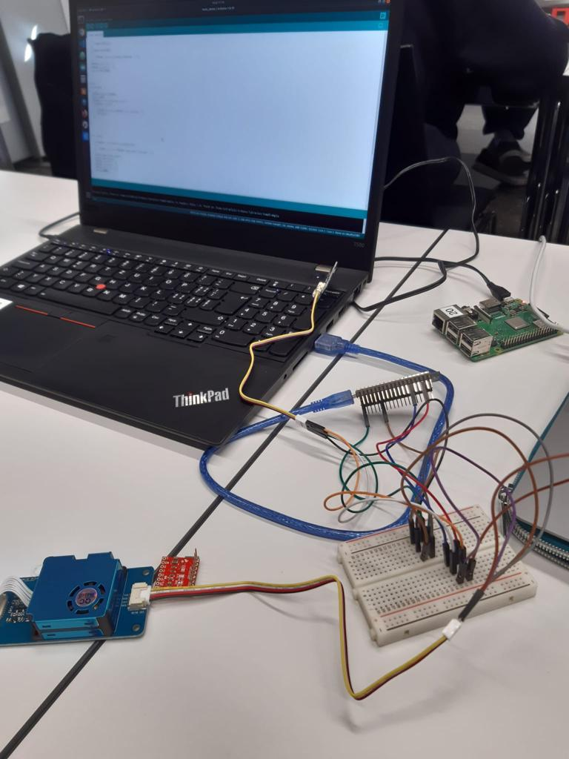
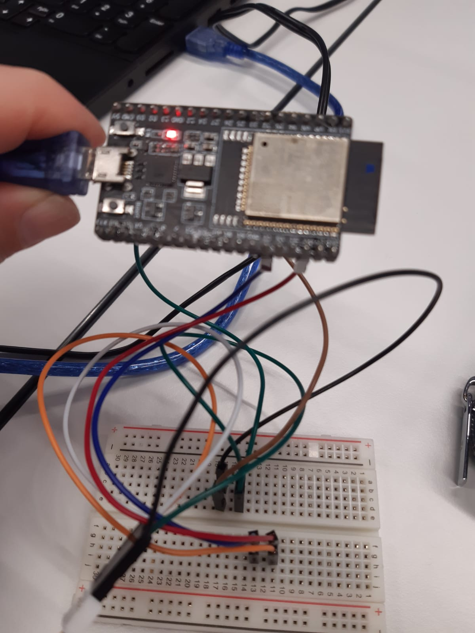
PROTOTYPE – THE START

Slide 18
04
REFLECTION

Slide 19
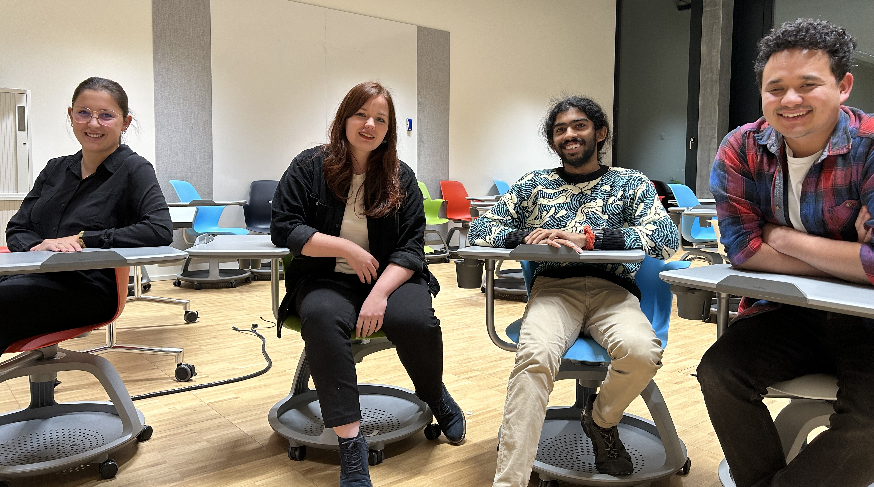
TEAMWORK
Jana Omcikus
Julia Naderer
Rohan Gundala
Sabin Pun
Frontend Tech
Project Lead
Backend Tech
Research

Slide 20
HIGHLIGHTS
HANDS-ON
TESTS
Creating a prototype from scratch to apply learned material
Walking around and trying to get different values
GETTING DATA
INTERFACE
Finally visualize the collected data on a web interface
First data collected from the sensors

Slide 21
FUTURE IMPROVEMENTS
Research
Automatization
Portability
Do more research on the different particles
Give instructions to external devices like:
air conditioner, windows, call fire fighters
Create the prototype that it can be carried everywhere

Slide 22
LIVE DEMO

